Slide 1

Confusion matrix
A confusion matrix is like a scorecard for a computer program that predicts things. It shows how many times the program got things right (true positives and true negatives) and how many times it made mistakes (false positives and false negatives). This helps us understand how well the program is doing and how to make it better.
This also implies that confusion matrices can only be used when the output distribution is known, i.e., in supervised learning frameworks.
In short
A confusion matrix is like a tool to see how often a computer prediction is correct and where it's making mistakes.

Slide 2
Case Study : Quality Control in a Manufacturing Process
Now, you create a confusion matrix to summarize the model's performance:
Cases 1000 | Predicted Defective | Predicted Non-Defective
Actual Defective | 90 (TP) | 10 (FN)
Actual Non-Defective | 20 (FP) | 880 (TN)
Analysis of the Confusion Matrix
True Positives (TP): These are the defective products correctly classified as defective. In this case, 90 defective products were correctly identified.
True Negatives (TN): These are the non-defective products correctly classified as non-defective. Here, 880 non-defective products were correctly identified.
False Positives (FP): These are the non-defective products incorrectly classified as defective. In this example, 20 non-defective products were mistakenly identified as defective.
False Negatives (FN): These are the defective products incorrectly classified as non-defective. In this case, 10 defective products were missed and classified as non-defective.

Slide 3
Case Study : Medical Test for a Rare Disease
After making predictions, you create a confusion matrix to summarize the model's performance:
Cases 500 | Predicted Positive (Has Disease X) | Predicted Negative (Does Not Have Disease X)
Actual Positive | 40 (True Positives) | 10 (False Negatives)
Actual Negative | 15 (False Positives) | 435 (True Negatives)
Analysis of the Confusion Matrix
True Positives (TP): These are the patients with Disease X correctly classified as having the disease. In this case, 40 patients with the disease were correctly identified.
True Negatives (TN): These are the patients without Disease X correctly classified as not having the disease. Here, 435 patients without the disease were correctly identified.
False Positives (FP): These are the patients without the disease incorrectly classified as having the disease. In this example, 15 patients without the disease were mistakenly identified as having the disease.
False Negatives (FN): These are the patients with Disease X incorrectly classified as not having the disease. In this case, 10 patients with the disease were missed and classified as not having it.

Slide 4
Case Study : Credit Card Fraud Detection
After model predictions, you construct a confusion matrix:
Cases 200 | Predicted Fraudulent | Predicted Legitimate
Actual Fraudulent | 45 (True Positives) | 5 (False Negatives)
Actual Legitimate | 10 (False Positives) | 1,940 (True Negatives)
True Positives (TP): These are the fraudulent transactions correctly classified as fraudulent. In this case, 45 fraudulent transactions were correctly identified.
True Negatives (TN): These are the legitimate transactions correctly classified as legitimate. Here, 1,940 legitimate transactions were correctly identified.
False Positives (FP): These are the legitimate transactions incorrectly classified as fraudulent. In this example, 10 legitimate transactions were mistakenly classified as fraudulent.
False Negatives (FN): These are the fraudulent transactions incorrectly classified as legitimate. In this case, 5 fraudulent transactions were missed and classified as legitimate.

Slide 5
 | Predicted
165 | No | Yes
Actual No | 50 | 10 | 60
Actual Yes | 5 | 100 | 105
 | 55 | 110
 | Predicted
165 | No | Yes
Actual No | 50 [TN] | 10 [FP] | 60
Actual Yes | 5 [FN] | 100 [TP] | 105
 | 55 | 110

Slide 6
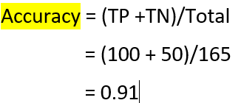
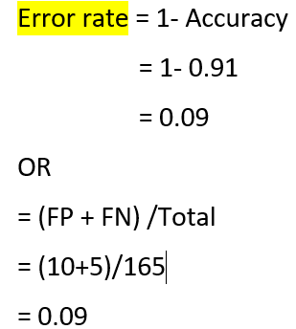
 | Predicted
165 | No | Yes
Actual No | 50 [TN] | 10 [FP] | 60
Actual Yes | 5 [FN] | 100 [TP] | 105
 | 55 | 110
Accuracy
Accuracy measures the proportion of correct predictions.
Accuracy = (True Positives + True Negatives) / Total Number of Predictions
Error rate
The error rate measures the proportion of incorrect predictions.
Error Rate = (False Positives + False Negatives) / Total Number of Predictions
https://www.youtube.com/watch?v=AyP85ocS-8Y

Slide 7
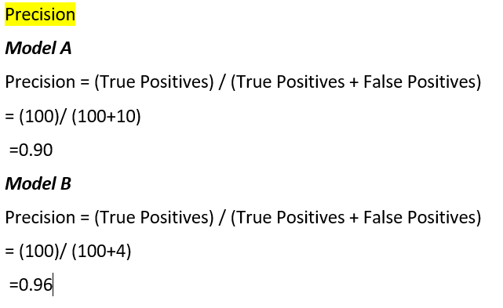
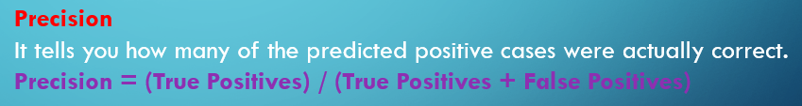
MODEL A | Predicted
165 | No | Yes
Actual SPAM No | 50 [TN] | 10 [FP] | 60
Actual SPAM Yes | 5 [FN] | 100 [TP] | 105
 | 55 | 110
MODEL B | Predicted
165 | No | Yes
Actual SPAM No | 50 [TN] | 04 [FP] | 60
Actual SPAM Yes | 11 [FN] | 100 [TP] | 105
 | 55 | 110
Which model you will prefer either model A or Model B?
Precision is important when false positives
(Type 1 Error) are costly.
https://www.youtube.com/watch?v=AyP85ocS-8Y
https://www.youtube.com/watch?v=iK-kdhJ-7yI

Slide 8
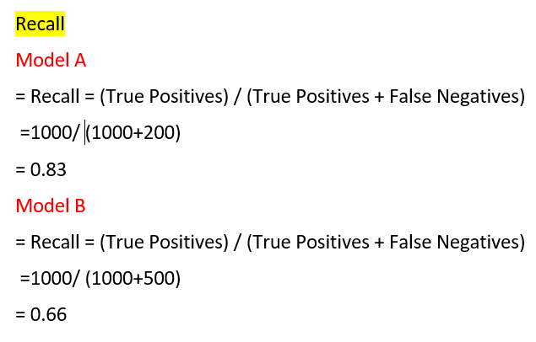
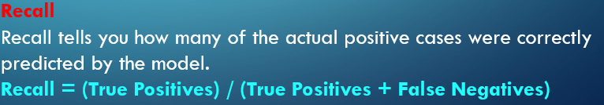
 |  | Predicted
Model A |  | Detected Cancer | Not Detected Cancer |  | Model B | Detected Cancer | Not Detected Cancer
Actual | Has Cancer | 1000 TP | FN |  | Has Cancer | 1000 TP | 500 FN
 | No Cancer | FP | TN |  | No Cancer | 500 FP | 8000 TN
Recall is important when false negatives (Type 2 error) are costly,

Slide 9
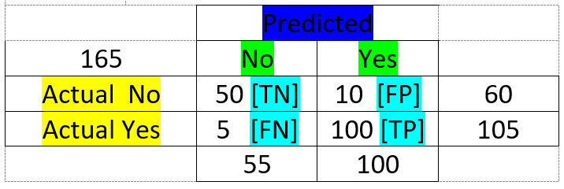
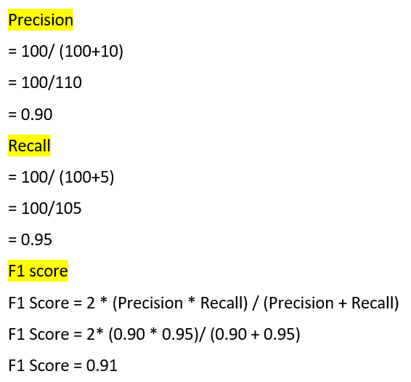
The F1 score is a metric that combines precision and recall to assess the accuracy of classification models. It provides a balanced measure of a model's ability to minimize both false positives and false negatives.
The best value of F1 score is 1 and worst is 0.
F1 Score = 2 * (Precision * Recall) / (Precision + Recall)
https://www.youtube.com/watch?v=AyP85ocS-8Y

Slide 10
Example
Suppose we have a binary class imbalanced dataset consisting of 60 samples in the positive class and 40 samples in the negative class of the test set, which we use to evaluate a machine learning model.
45 samples belonging to the positive class being predicted correctly.
32 sample belonging to the negative class being predicted correctly.
8 sample belonging to the negative class but being predicted wrongly as belonging to the positive class.
15 sample belonging to the positive class but being predicted wrongly as belonging to the negative class.
Create confusion metrics, calculate accuracy, precision, recall and F1 score.

Slide 11
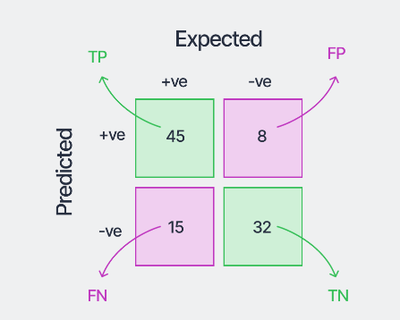
Solution

Slide 12
